Slide 1
Book Review by
Mr. S. Anand Reddy
THE RUPERT MURDOCH
WAY
(Ten secrets of the world’s greatest deal maker)
BY
STUART CRAINER

Slide 2
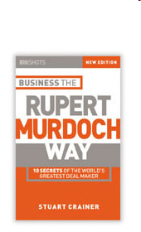

Slide 3
BOOK DETAILS
Author : STUART CRAINER
Country : United States
Language : English
Publisher : Magna Publishing Co. Ltd
First Edition : July, 2003
Pages : 147
ISBN : 81 – 7809 – 187- 9

Slide 4
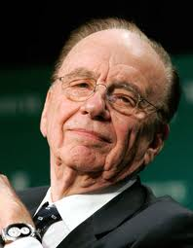
ABOUT RUPERT MURDOCH
BORN :: 11Mar 1931, Melbourne, Australia.
PARENTS :: Keith Murdoch, Elisabeth Joy
OCCUPATION :: Chairman & CEO of News
Corporation.
SPOUSE :: Anna Maria Torv (divorced)
Patricia Booker (divorced)
Wendi Deng (present)
CHILDREN :: Prudence, Elisabeth, Lalchan,
James, Grace, Chole
NETWORTH :: US$7.6 Billion (2011)
CITIZENSHIP :: United States (1985)

Slide 5
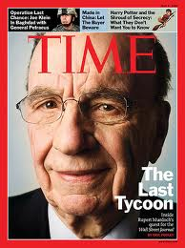
MURDOCH’S WORLD
Technologies:
Broad systems, chinabyte.com
Entertainment:
Star, fox, British sky, National geographic, F/X ,20th Century Fox.
Publishing:
HarperCollins, The Weekly Standard, The Wall Street Journal.
Newspapers:
New York Post, The Sun,
The Sunday Times, The Times,
The Australian, Melbourne Herald Sun

Slide 6
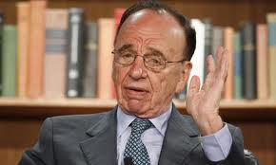
HISTORY
1953 :: MD of News Limited inherited from his father.
1969:: Expanded to UK taking over News of the World, The Sun.
1981 :: He bought The Times His 1st British Broadsheet.
Murdoch has been listed three times in the Time 100 as among the most influential people in the world.
He is ranked 13th most powerful person in the world in the 2010 Forbes' The World's Most Powerful People list.
He was ranked 117th wealthiest person in the world in March 2011.

Slide 7
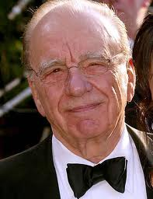
10 SECRETS OF DEAL MAKING

Slide 8

GO WITH FLOW
Move with the Times.
Constantly update your network of contacts.
Get close to the corridors of power.

Slide 9

GOODBYE Mr. NICE GUY
Recruit Strong People.
Backtracking is Weakness.
Compete to Win.

Slide 10
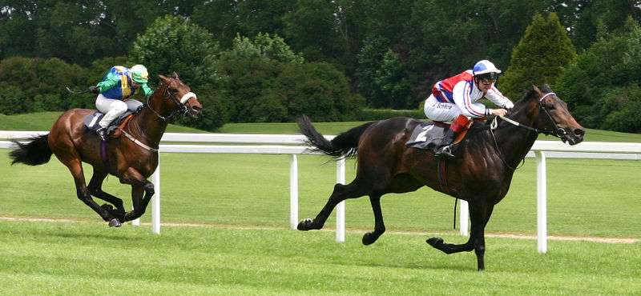
PLACE YOUR BETS
Risk taking is the essence of managerial
decision making.
Keep your nerve when the race is on.
Losing is the part of the game.

Slide 11

LEAD FROM THE FRONT
Old fashioned leadership is not dead.
Vision.
Trust.

Slide 12
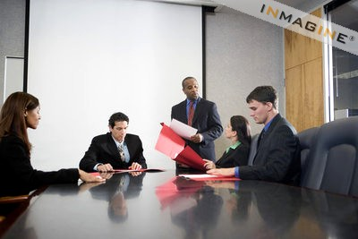
KING OF THE NITTY GRITTY
Know the business.
Disciplined attention.

Slide 13
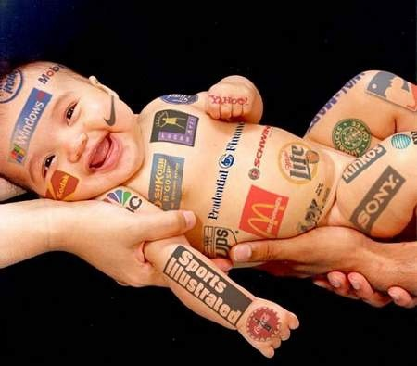
DNA MARKETING
Know your customer.
Move fast.
Excel at everything you do.

Slide 14
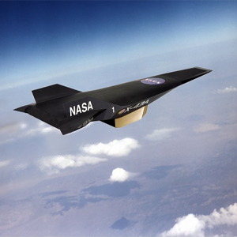
SPEED FREAKS
Move fast.
Organize accordingly.
Eliminate hierarchy.

Slide 15
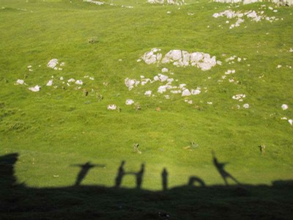
THINK TOMORROW TODAY
Invest time in considering the future.
Embrace technology.

Slide 16

AMBITION NEVER DIES
Keep learning.
Keep Questioning.
Keep making mistakes.

Slide 17

DRIVE THE COMPANY
Change is the route to success.
Young at heart.
Cultivate revolution.

Slide 18
CONCLUSION
This a book which tells about the Life of Keith Rupert Murdoch and his successful journey in his business and the hurdles he faced while expanding the business.
This book also tells his secrets of his success in his great deal making.

Slide 19


